Slide 1


Slide 2
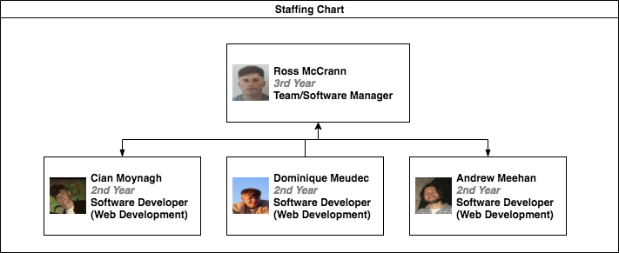

Slide 3
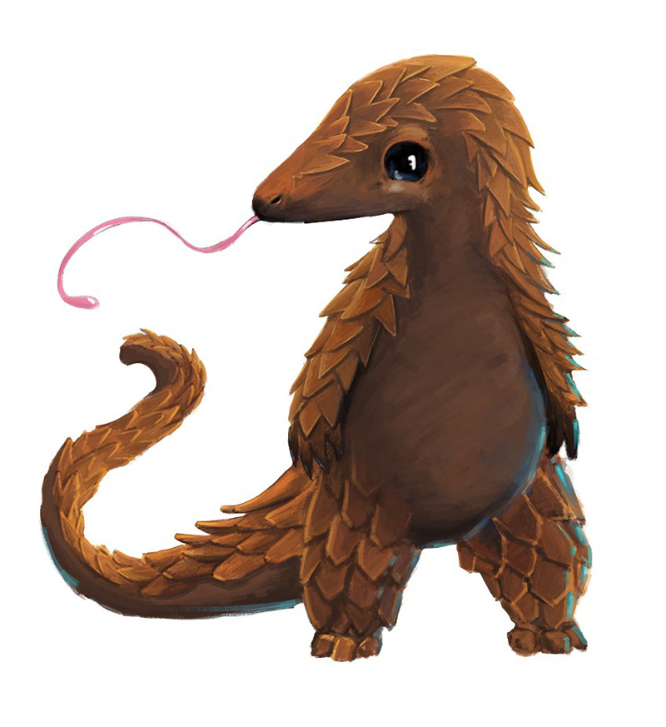

Project Description
Create a browser extension that provides a virtual pet (pangolin) as an animated mini pet that users will be able to interact with in a multitude of engaging ways when a new window is opened in their browser.
Fully featured website that provides information on the Pangolin as well as a way to donate to a charity related to the species.

Slide 4
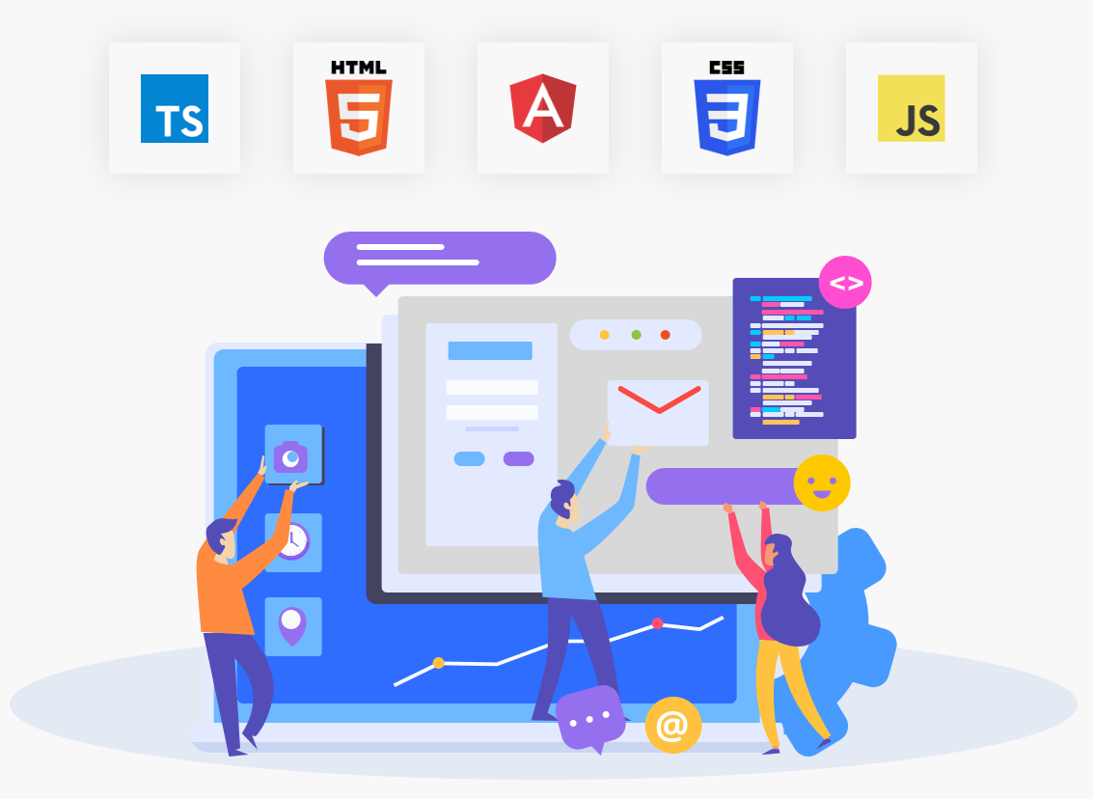
Implementation
We implemented a browser extension for Google Chrome and fully featured website using a web development stack.
The technologies used to implement the project were JavaScript, JQuery, HTML & CSS as well as a host of web development libraries and frameworks.

Slide 5
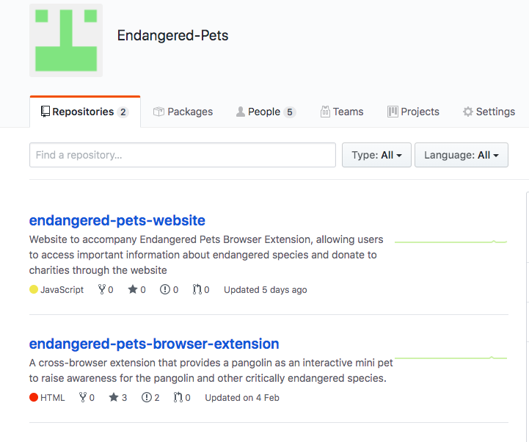
Challenges
Open Source: Github organisation and repo for the project that can be maintained and added to by OS developers.
Design: Project required a lot of UI, UX and Design.
Steep-Learning curve: Many new technologies to learn.
Small, Inexperienced Team: Only one third year.
Coronavirus Pandemic: Remote Work and Collaboration.

Slide 6
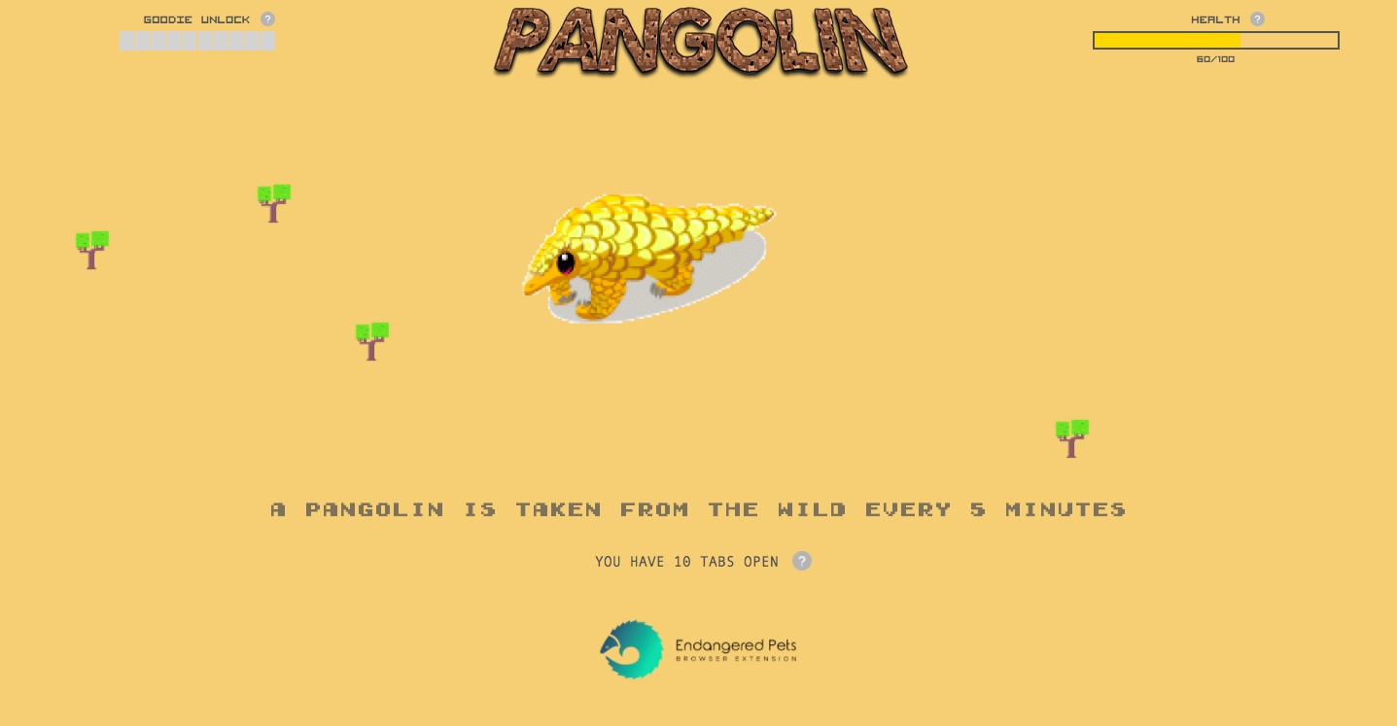
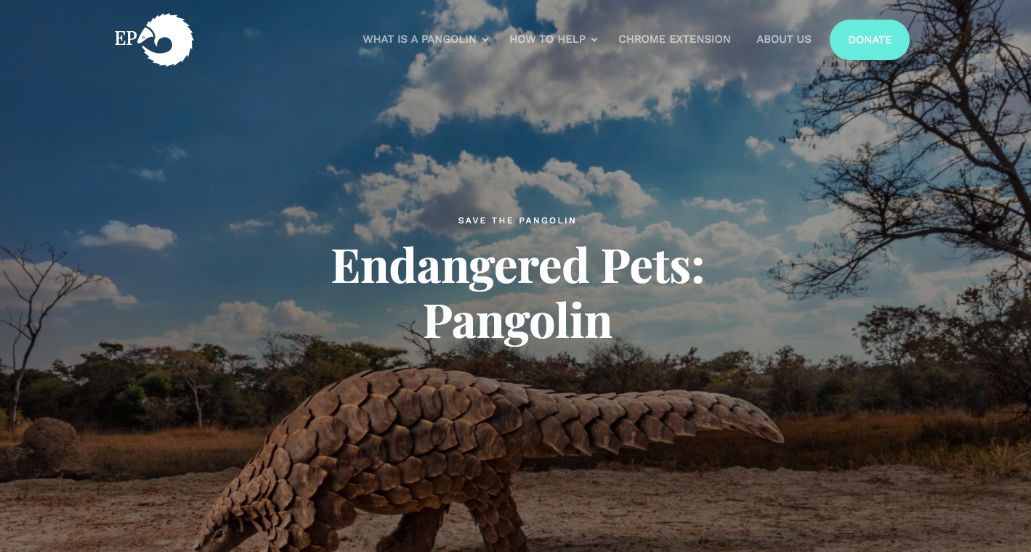
Final Thoughts
The group delivered above and beyond what was asked of us by the client in creating a visually appealing, informative and interactive browser extension and website.
The group worked very well researching and learning new technologies.
The client is thrilled with the project that we have delivered in a short time frame.
The group was able to overcome many setbacks and challenges.

Slide 7

Video Demo

Slide 8
Thank You!

